Slide 1

The Impact of Social Media Challenges on Burn Injuries in Youth
Yu Ting Tay
Launceston General Hospital

Slide 2
Introduction
Dangerous peer pressure and the associated self-harming act amongst youth have existed since before, internet has increased the spread and the awareness of these phenomena
Social media platforms have become fertile ground for viral challenges, many of which pose serious risks to young participants.
These challenges often promise social validation through likes, followers, or perceived bravery, leading adolescents to engage in dangerous behaviors to appear "cool" or courageous.[1]
Curiosity also draws them to try various challenges.[1]

Slide 3
Aim
To raise awareness about the connection between social media and burn injuries in youth
Highlighting the need for preventive strategies to reduce harm.

Slide 4
Trends
Flame burn
Contact burn
Friction burn
Cold burn
Chemical burn
Direct of indirectly related to source of heat

Slide 5
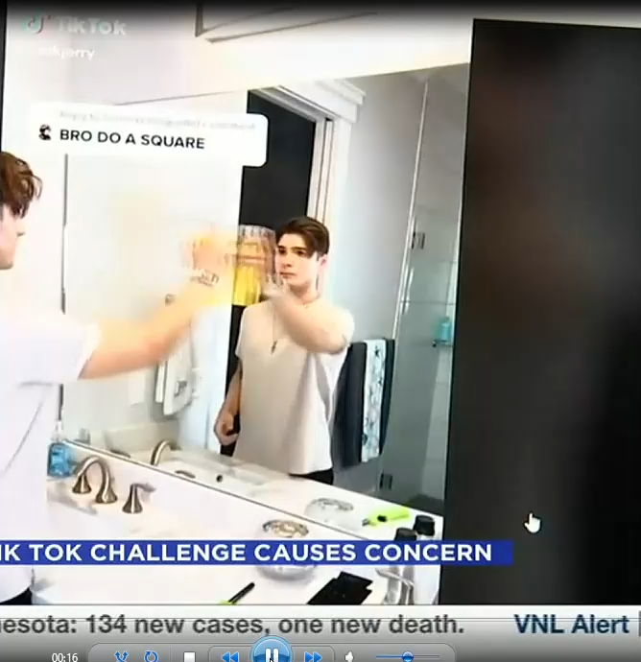
Cologne Challenge/Mirror fire challenge
Participants pour cologne on the mirror, switch off the lights and hold a lighter near it, resulting in severe burns.[1]
Notes:
https://www.valleynewslive.com/2021/06/02/a-tik-tok-challenge-involving-fire-causes-concern/

Slide 6
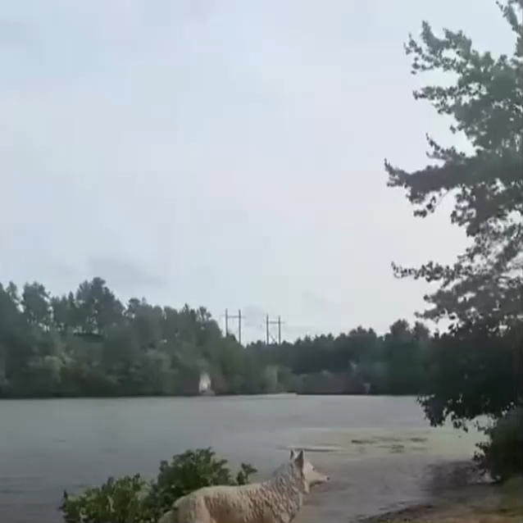
Fire Challenge
Involves setting alcohol-soaked clothing on fire or combining hairspray and lighters to create flames—both of which have led to significant flame burns in children.[3] The "Fire Challenge" encourages individuals to douse themselves in rubbing alcohol and set it alight, often resulting in extensive injuries.
Resulting in severe injury requiring surgery.
[4]
Notes:
https://www.youtube.com/watch?v=T3KriBSniQ4

Slide 7
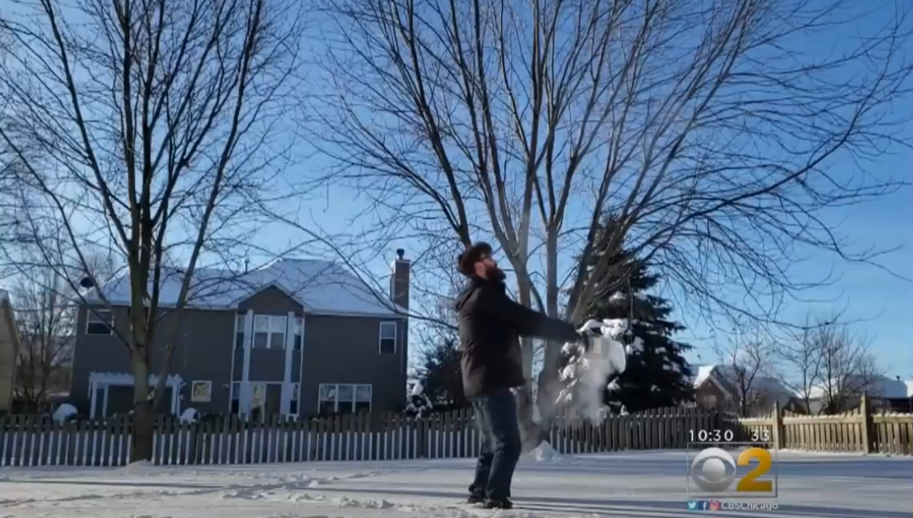
Boiling Water Challenge
Participants throw boiling water into cold air expecting it to freeze mid-air, has caused serious scald burns, particularly to the face and upper body.[5]
Giving excellent picture effect.
Bad aim and bad throw resulting in severe scald burn. Some bystander affected
[6]
Notes:
https://www.youtube.com/watch?v=-qohd0nK6fk

Slide 8
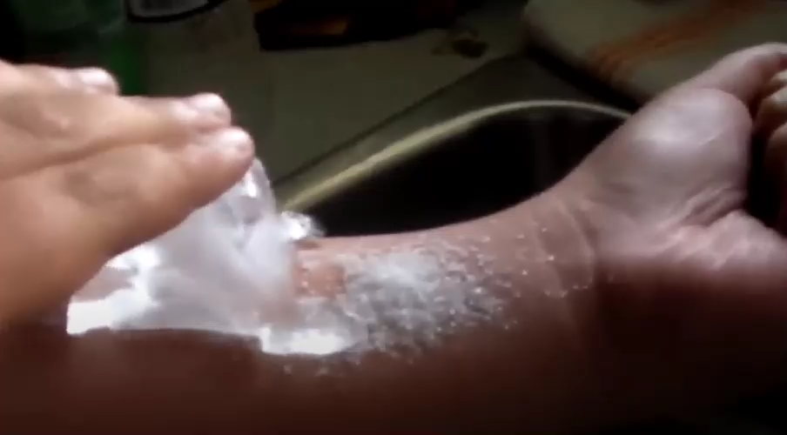
Salt and ice Challenge
Another notable trend is the “salt and ice” challenge where participants drop as much ice on themselves as they could bear after pouring salt on their hands.[1]
Resulting 2nd degree burn. [7]
Notes:
https://youtu.be/51n3F0O707w

Slide 9
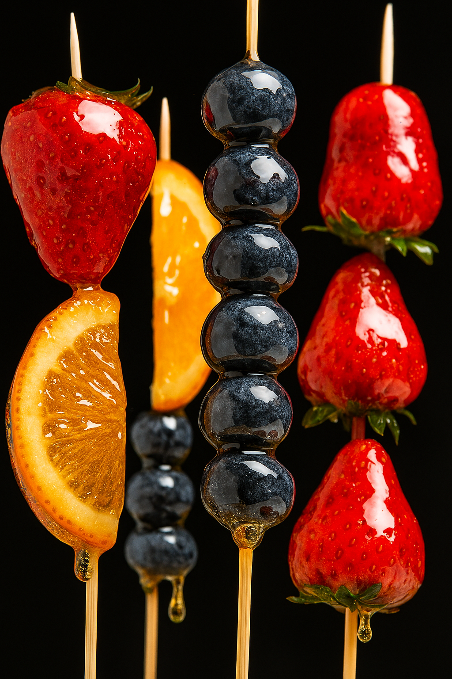
Candied sugar challenge
Heating sugar and water in plastic container within microwave to make candied fruit. Plastic container become so hot causing hot sugar water and plastic to drip on the child.
[8]

Slide 10
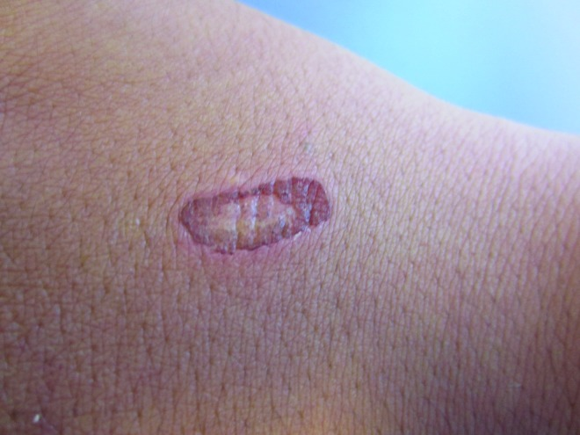
Eraser challenge
Self destructive behavior.
Rubbing eraser on each hand for 30 seconds until skin come off
Case report to be caused by simple curiosity and complete friends dare
Wound is acquired as a “trophy”
[9]

Slide 11
Planking challenge
Random planking area such as dangerous place near kitchen/dangerous chemicals

Slide 12
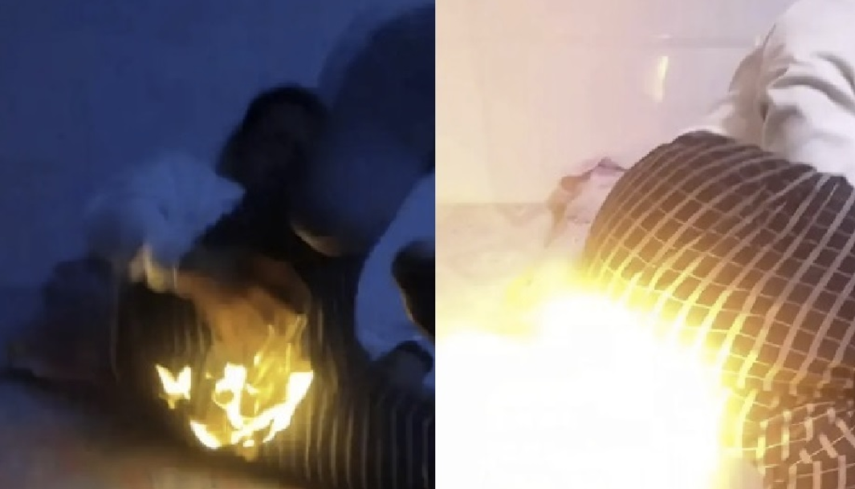
Fart lighting challenge
Lighting up fart, resulting in clothes caught on fire

Slide 13
Prevention strategies
Parents
Medical practitioner
Government

Slide 14
Digital platform responsibility
Increase parental supervision
Restriction of content

Slide 15
Education and awareness
Research is needed to understand how social media influences youth behaviour.
Robust internet safety education
The medical practitioner needs to be aware of the current trends that may be the cause of their younger cohort patient’s injuriRs so that appropriate treatment can be administered promptly besides educating patients and parents. [10]

Slide 16
Government role
Policy measures to restrict or penalize harmful content could play key roles in protecting young people from preventable injuries.
Using social media itself to deliver public health message. [11]
Implementing law restricting social media account in minor ( 10 December 2025)

Slide 17
Conclusion
Preventing social media trends related to burn injuries requires a collaborative effort between social media platforms, parents, healthcare provider. By fostering awareness and promoting safe online behavior, we can reduce the number of tragic burn incidents linked to viral challenges.

Slide 18
References
1. Dayı S, Beyeç S, Dede B, İşçimen S, Anayurt M, Sancar S (2024) ‘Social Media: A notable cause of child burns. Burns open : an international open access journal for burn injuries. 2024;8(2):97-100. doi:10.1016/j.burnso.2024.02.003
2. Taylor, N. (2021) A Tik Tok Challenge involving fire causes concern, https://www.valleynewslive.com. Available at: https://www.valleynewslive.com/2021/06/02/a-tik-tok-challenge-involving-fire-causes-concern/ (Accessed: 24 September 2025).
3.Lombardo GAG, Camilloni C, Violini H, et al. Cyber social proof and hazard: Investigating the impact of social media on pediatric burn incidents – Analysis and comprehensive literature review. Annales de chirurgie plastique et esthétique. 2024;69(5):442-448. doi:10.1016/j.anplas.2024.05.006
4.NBC 10 (2025)YouTube. Available at: https://www.youtube.com/watch?v=T3KriBSniQ4 (Accessed: 24 September 2025).
5. Doh CY, Maluso PJ, Kohler CL, Dvorak JE. Burn Injuries From TikTok Challenges: A Brief Report. The American SurgeonTM. 2023;90(5):1098-1099. doi:10.1177/00031348231220568

Slide 19
References
6. CBS Chicago (2019) Boiling Water Challenge Leaves 8 Burned During Polar Vortex YouTube. Available at: https://www.youtube.com/watch?v=-qohd0nK6fk (Accessed: 24 September 2025).
7. KTNV Channel 13 Las Vegas (2016) Salt and ice challenge YouTube. Available at: https://www.youtube.com/watch?v=51n3F0O707w (Accessed: 24 September 2025).
8. Storey, K., Burns, N., Kerr, R., Holbert, M., Kimble, R., & Griffin, B. (2025). Severe burns from viral TikTok challenge involving candied sugar: A case series report. Burns Open : An International Open Access Journal for Burn Injuries, 11, Article 100410. https://doi.org/10.1016/j.burnso.2025.100410
9. Deklotz, C. M., & Krakowski, A. C. (2013). The Eraser Challenge Among School-age Children. The Journal of clinical and aesthetic dermatology, 6(12), 45–46.
10. Chu V, Begaj A, Patel L. Burns challenges – A social media dictated phenomena in the younger generation. Burns open : an international open access journal for burn injuries. 2018;2(2):94-97. doi:10.1016/j.burnso.2017.12.002
11. Batra, N., Colson, C. D., Alberto, E. C., & Burd, R. S. (2021). Using Social Media for the Prevention of Pediatric Burn Injuries: Pilot Design and Usability Study. JMIR formative research, 5(7), e23242. https://doi.org/10.2196/23242

