Slide 1
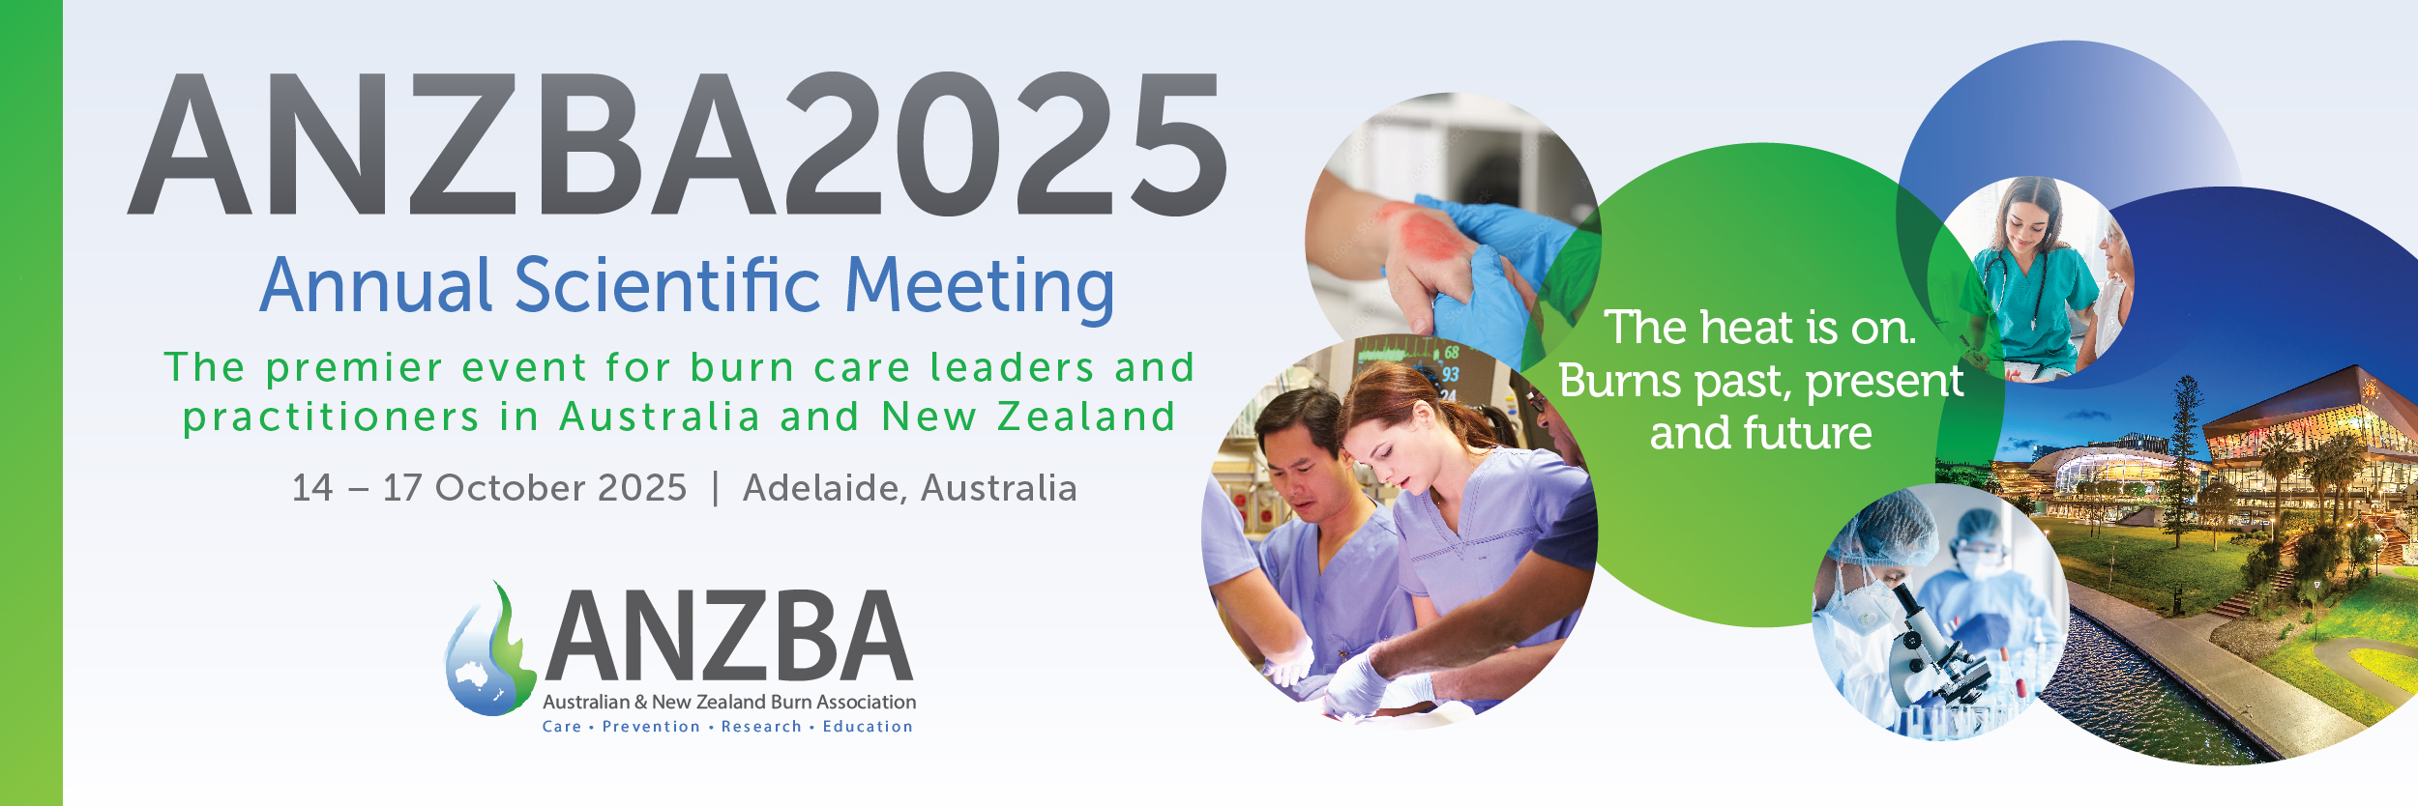


Artificial Intelligence in Burn Assessment Preliminary Experience Using Artificial Intelligence and Multispectral Imaging for Burn Depth Assessment
Hollie Moran
Dominique White, Lindsay Shanks, Elizabeth Concannon, Nicholas Solanki, Marcus Wagstaff

Slide 2
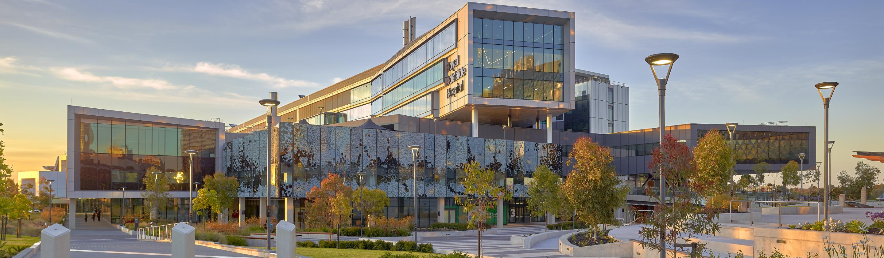
Disclosures
DeepView® Wound Imaging Device provided free of charge by SpectralAI®
No funding was provided and no involvement in research design
All patients consented to use of DeepView® Imaging device and photography

Slide 3
Background
History
Clinical exam
Assessment of burn depth is difficult and subjective.
Accurate early prediction of healing is critical → guides decision for surgery vs non operative management
Patient workup: history, clinic exam and investigations guide management plans
Burn depth assessment often based on history, examination (or photos) – lacking effective investigations
Diagnosis and Management
Investigations
Notes:
laser doppler as this is the most widely used investigational tool used to assess burn depth currently. However it is difficult and cumbersome which is why we dont use it but there are some units that use it routinely. You dont need to necessarily write it on the slide but I would make mention of it

Slide 4
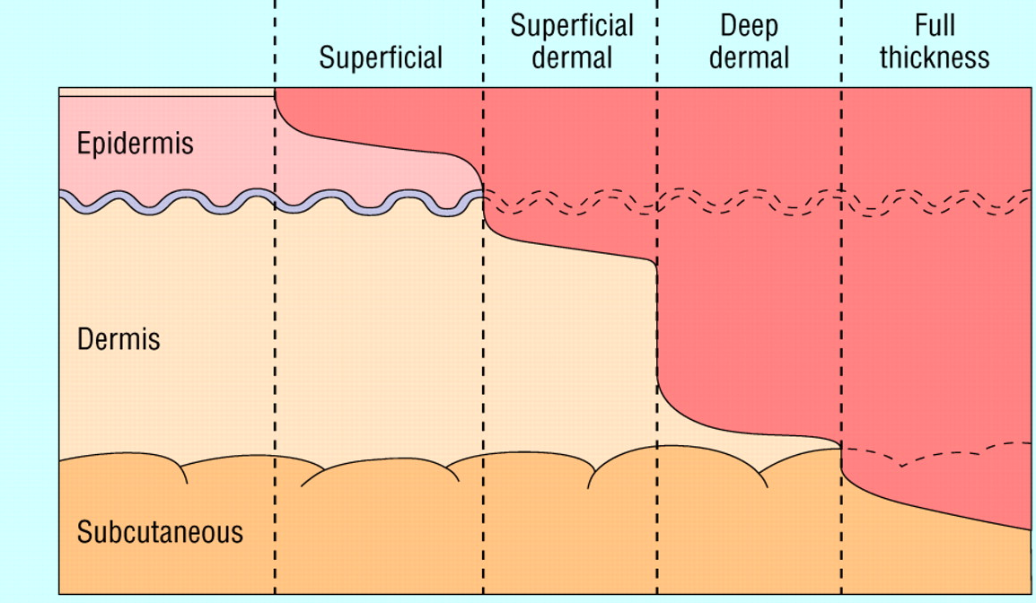
Background
Current challenge in burn assessment:
Reliance on clinician judgement
Subjective, variable accuracy
May delay definitive treatment while waiting for areas to declare
Over/ under calling
Initial assessment often not by burn specialist

Slide 5

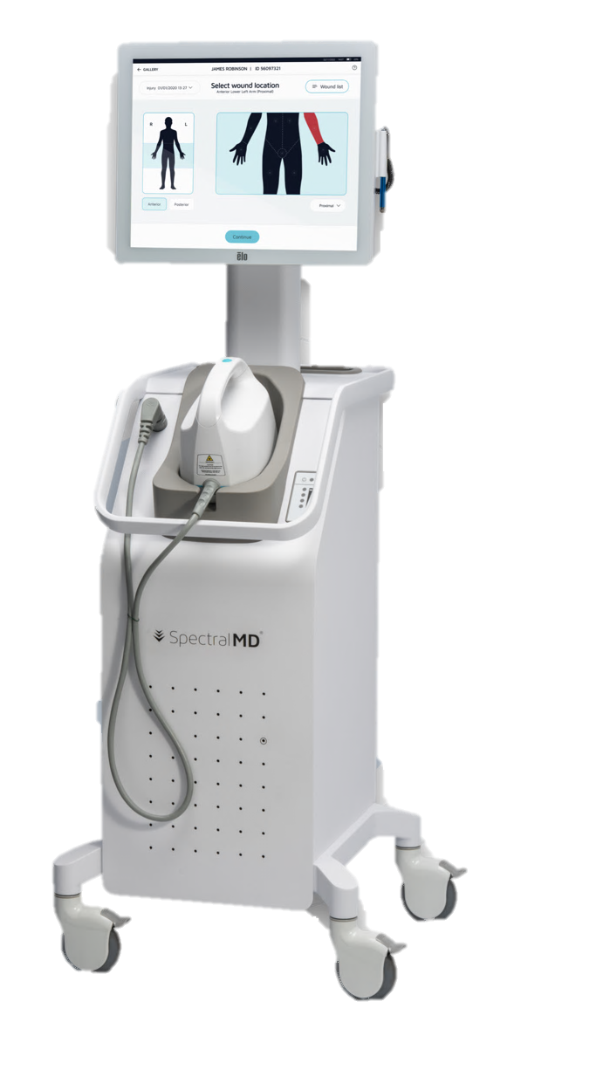
Background – the device
DeepView® Snapshot Imaging Platform
Non-invasive, bedside multispectral imaging
Uses AI to predict healing within 21 days.
Provides objective data to support clinical decision making.
Potential applications:
Initial triage (ED/primary care).
Specialist burn unit decision making

Slide 6
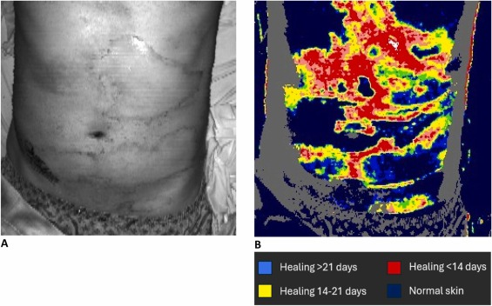
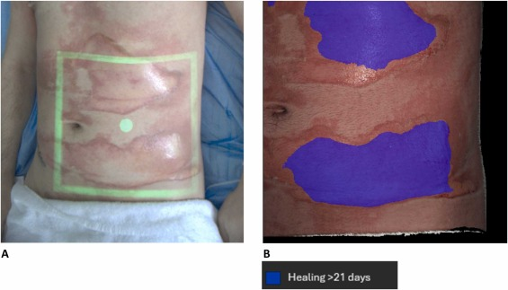
Background – the device
Multispectral imaging
Shines light at multiple wavelengths (from visible to near-infrared)
Different tissues absorb and reflect light differently
Creates multispectral “map” of burn
Artificial Intelligence Algorithm
Image data + patient demographics processed, AI trained on database of burn biopsies and healing outcomes
Generates prediction
Visual image of healing vs non-healing at 21 days
Notes:
1. Multispectral Imaging
The device shines light at multiple wavelengths (from visible to near-infrared) onto the burn wound.
Different tissues (healthy dermis, damaged dermis, necrotic tissue) absorb and reflect light differently.
The camera captures the reflected light patterns, creating a multispectral “map” of the burn.
2. Data Processing
The reflected light data is processed to highlight subtle differences in tissue properties that are invisible to the naked eye.
These spectral signatures correlate with burn depth and tissue viability.
3. Artificial Intelligence Algorithm
The captured image data, along with basic patient information (e.g., demographics), is fed into the DeepView AI algorithm.
The algorithm has been trained on a large reference database of burn biopsies and healing outcomes.
It compares the new patient’s wound data to this database to generate a prediction.

Slide 7
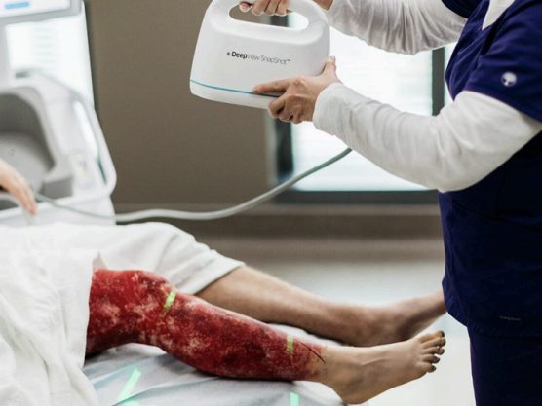
How to Use
Input patient data
e.g. age, gender, time of burn, date of surgeries, comorbidities
Select burn location
R/L, A/P, medial/ lateral
If >1 burn can perform separate locations
Capture Image
Adjust camera until magenta light turns neon green
Run healing prediction
1
2
3
Dark room
Pat dry – so no moisture reflection
Neutral background
4

Slide 8
Our project:
Aim
Compare the accuracy of specialist burns surgeons vs SpectralAI DeepView® Snapshot in predicting 21-day healing outcomes.
Assess feasibility and potential role of the device in clinical practice.

Slide 9
Method
Prospective study at RAH Burns unit
Adult patient with acute burns consented for study
Process:
Experienced burns surgeons predicted healing by 21 days
SpectralAI device used, and prediction recorded.
Primary outcome: clinical assessment compared to SpectralAI
Secondary outcome: Actual healing of partial thickness burns that are expected to heal on clinical assessment at 21 days compared to SpectralAI

Slide 10
Method
Inclusion
Patients with burns who presented to RAH Adult Burns Unit: inpatient + outpatient
Flame/Scald/Contact Burns
Burns <1 week old
Exclusion
Superficial burns
Non validated sites: hands, feet, head/neck, genitals
Burns > 1 week old
Chemical Burns
Electrical Burns

Slide 11

Results
Sensitivity 71%
Specificity 83%
PPV 90%
NPV 55%
AI agreement with expert clinical opinion:
52 Patients, 132 Burns
5-month period (data collection ongoing)
31 male, 21 female patients
Burn type:
56% flame burns (74)
34% scald burns (45)
10% contact burns (13)
AI correctly predicted healing outcome: 70%

Slide 12
Example cases

Slide 13
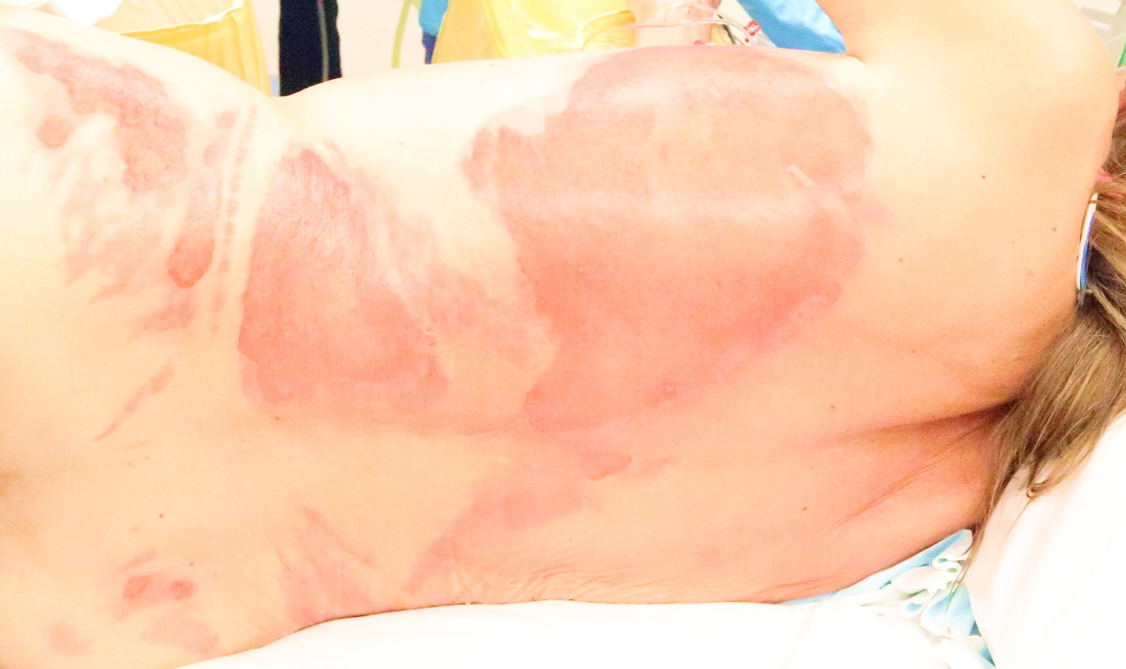
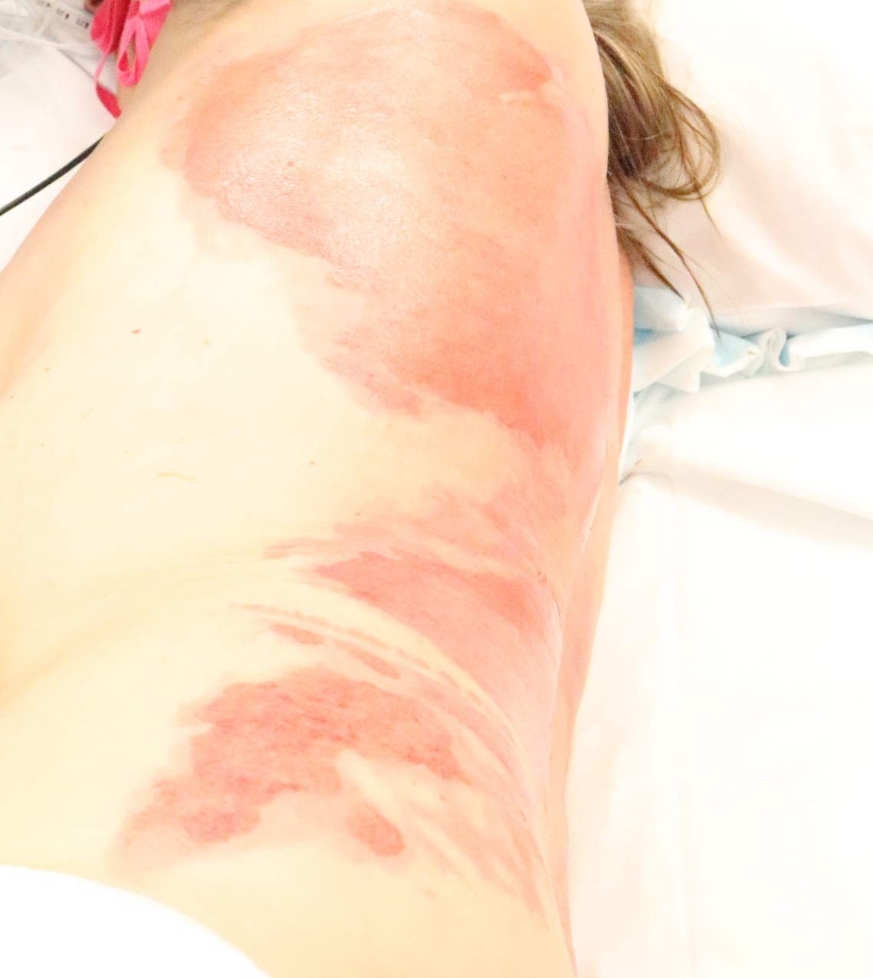
Patient 1
79F home alone, independent. 7% TBSA Hot water scald from hot water bottle, left flank and back
On presentation clinician Prediction: Will heal within 3 weeks

Slide 14
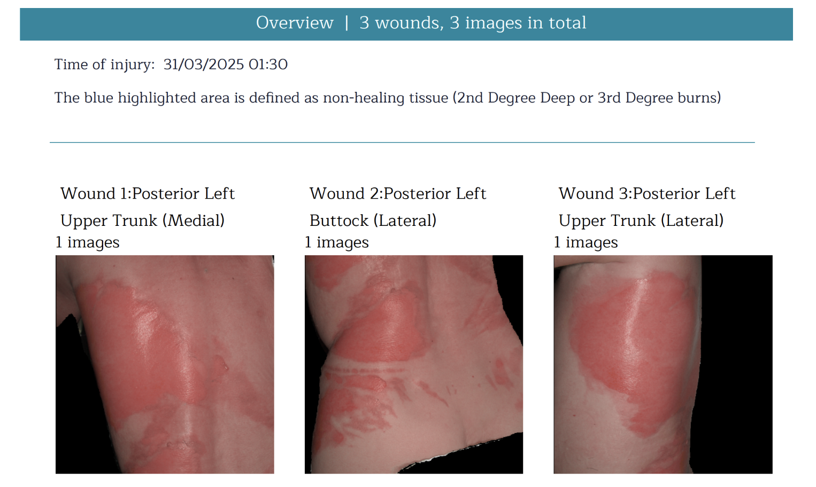
Patient 1
Spectral AI prediction: Will heal within 3 weeks (blue highlighted area indicates non healing tissue)

Slide 15
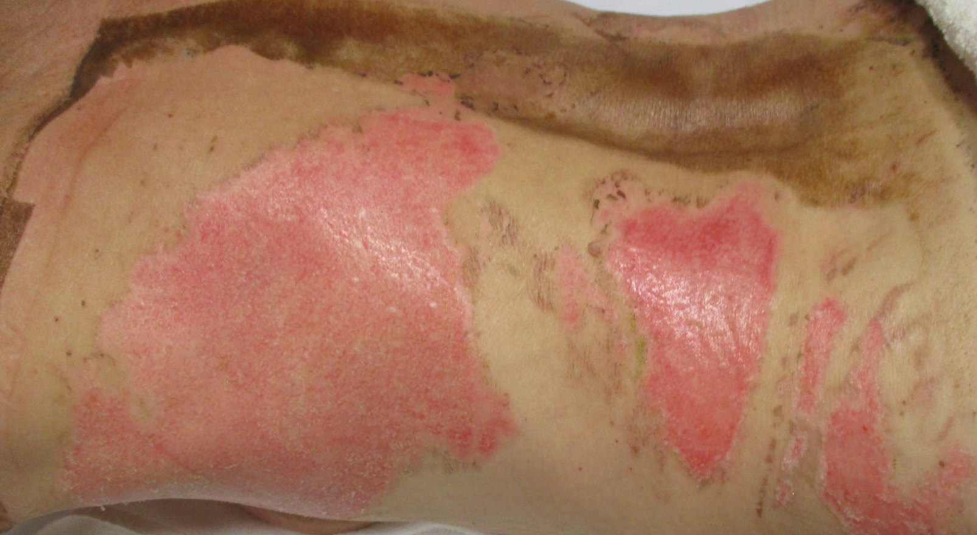
Patient 1
Outcome at 21 days: healed

Slide 16
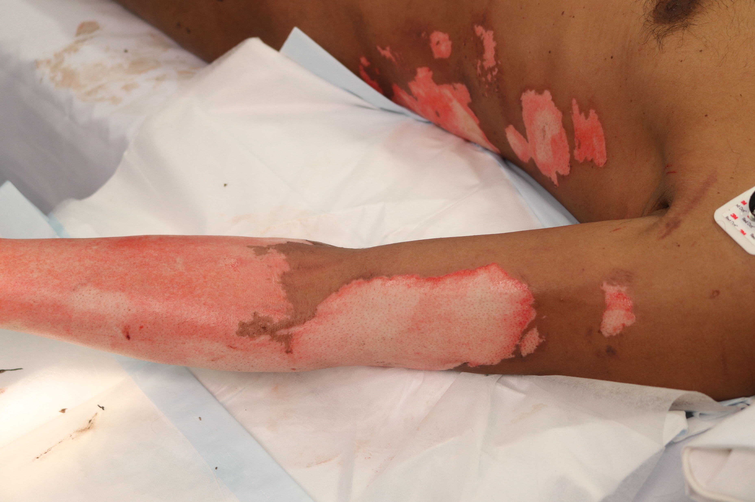
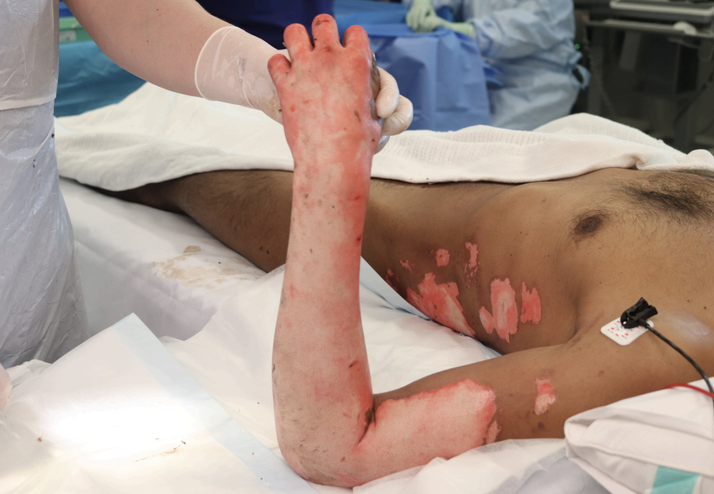
Patient 2
36M 8% TBSA flame burn to left upper limb and left trunk
On presentation clinician Prediction: Will NOT heal within 3 weeks (blue highlighted area indicates non healing tissue)

Slide 17
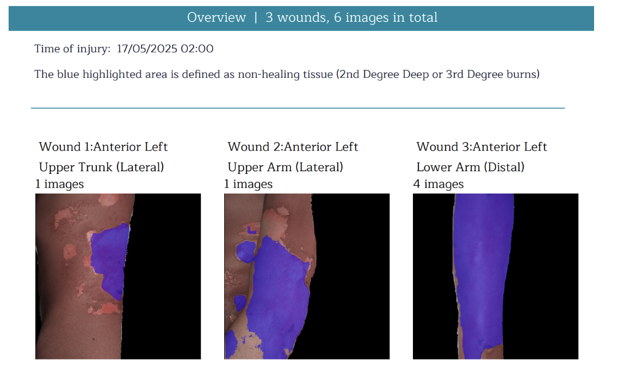
Patient 2
Spectral AI prediction: Will NOT heal within 3 weeks (blue highlighted area indicates non healing tissue)

Slide 18
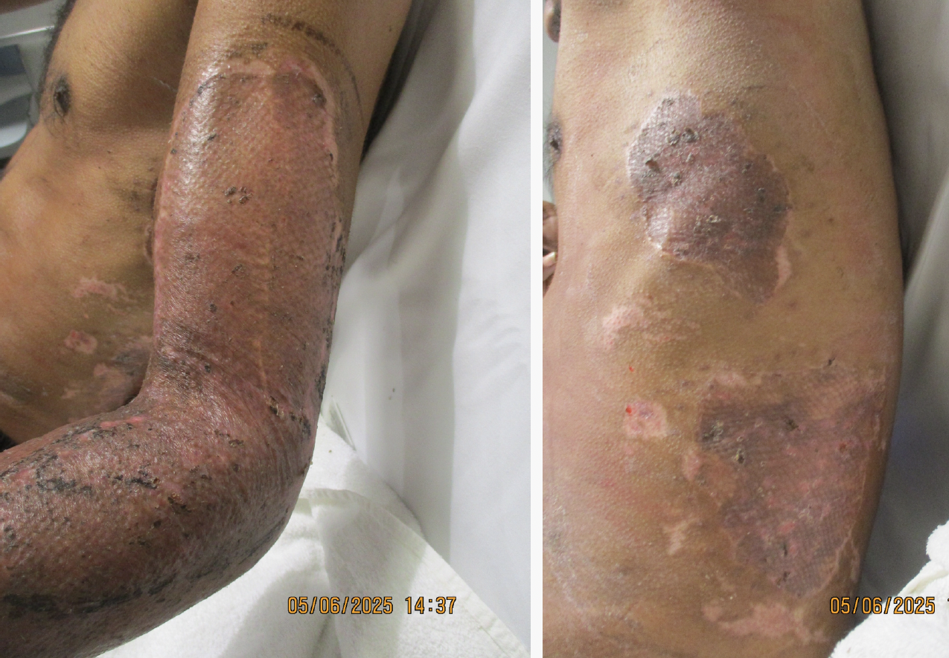
Patient 2
Outcome at 21 days: was grafted, grafts taken

Slide 19
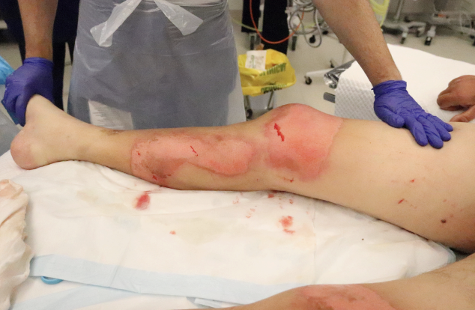
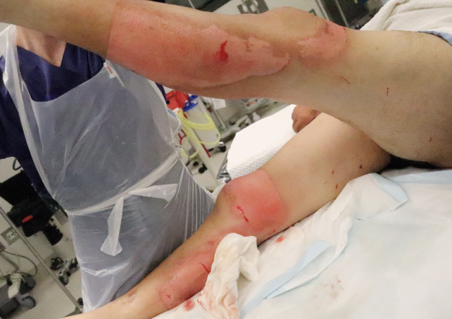
Patient 3
73 M 6.7% TBSA flame burn to bilateral legs, face
On presentation clinician Prediction: Will heal within 3 weeks

Slide 20
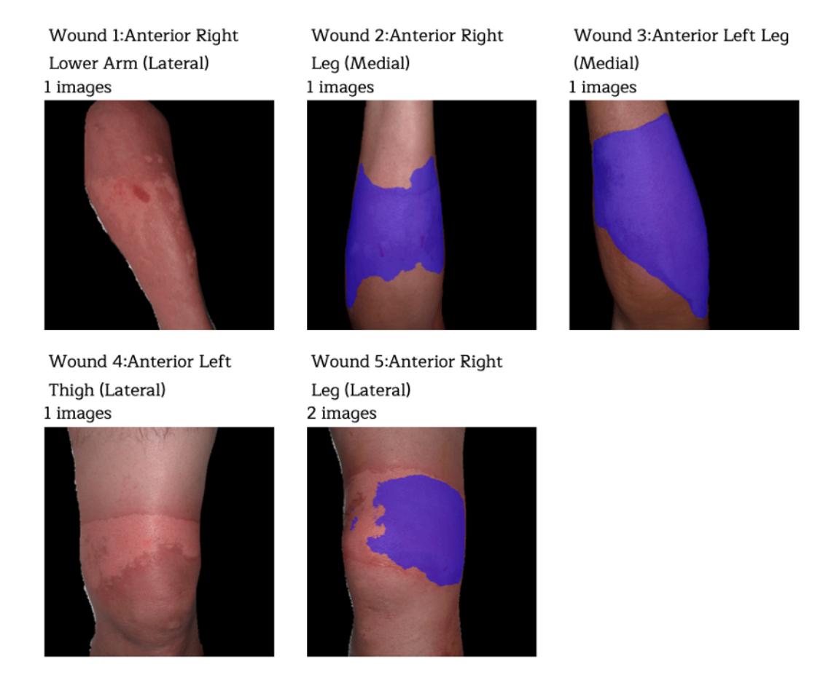
Patient 3
Spectral AI Prediction:
Left anterior thigh - Will heal within 3 weeks
Anterior right lower leg + thigh, anterior left leg - Will NOT heal within 3 weeks

Slide 21
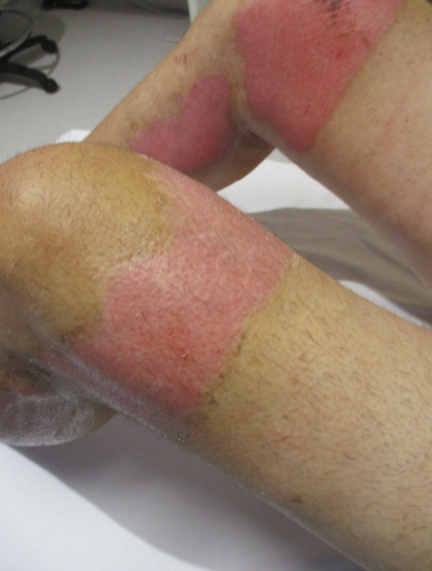
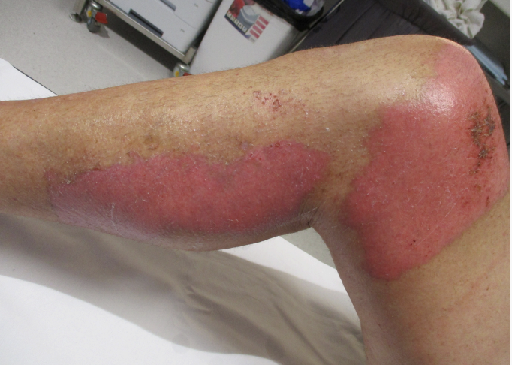
Patient 3
Outcome: all burns healed by 21 days

Slide 22
Limitations
When determined to be not healing by clinician patients are grafted, therefore burn does not run until 21 days
Small, single-centre study
Does not account for comorbidities or clinical feel (capillary refill, sensation).
Some imaging artefacts (reflection, moisture).

Slide 23
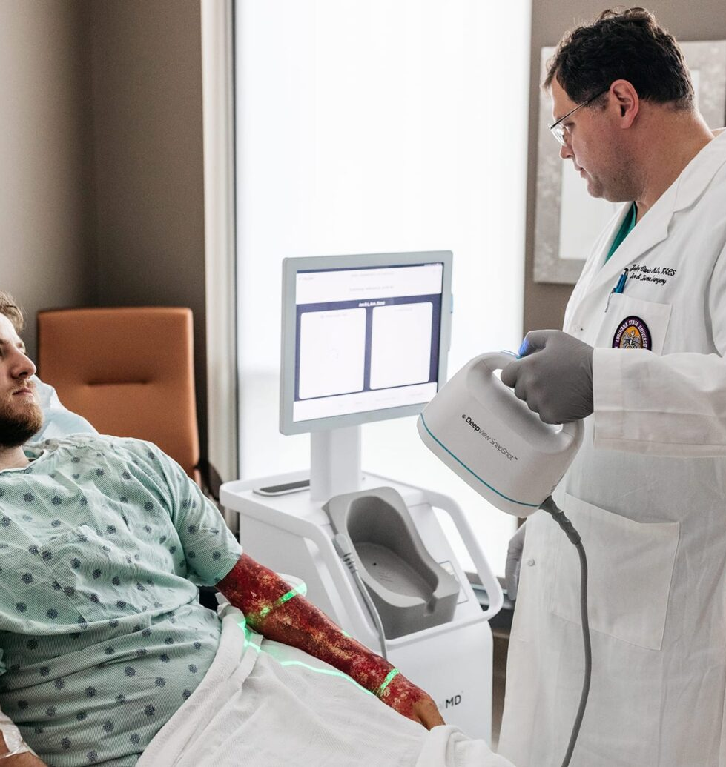
Future directions
Expand to larger, multicentre studies.
Validation across different burn types, body parts and patient demographics.
Explore integration into ED triage pathways and AI-assisted decision-making tool

Slide 24
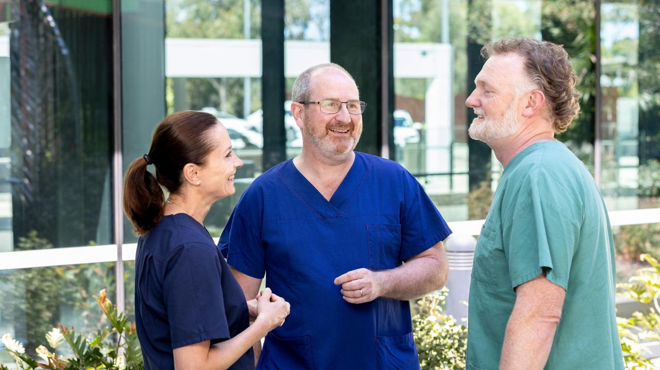
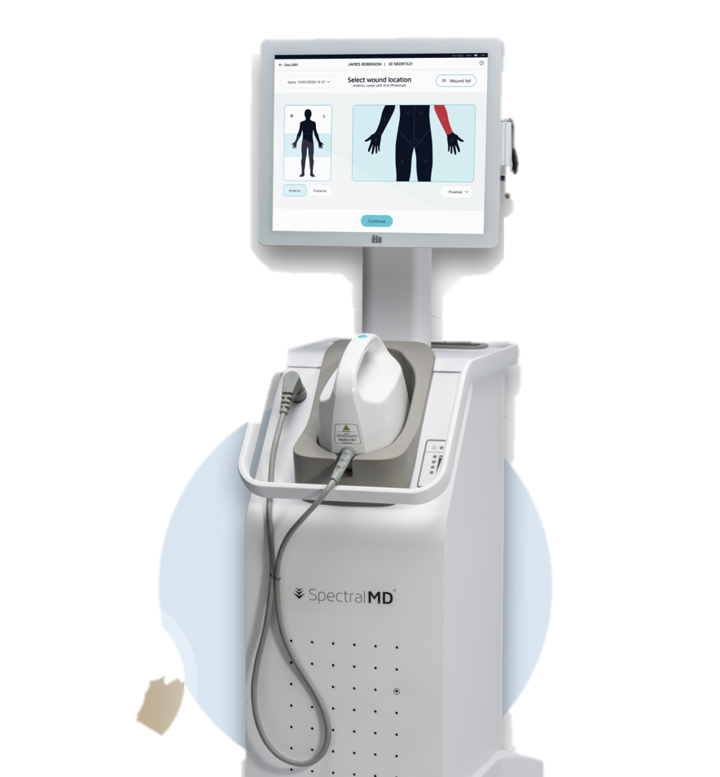
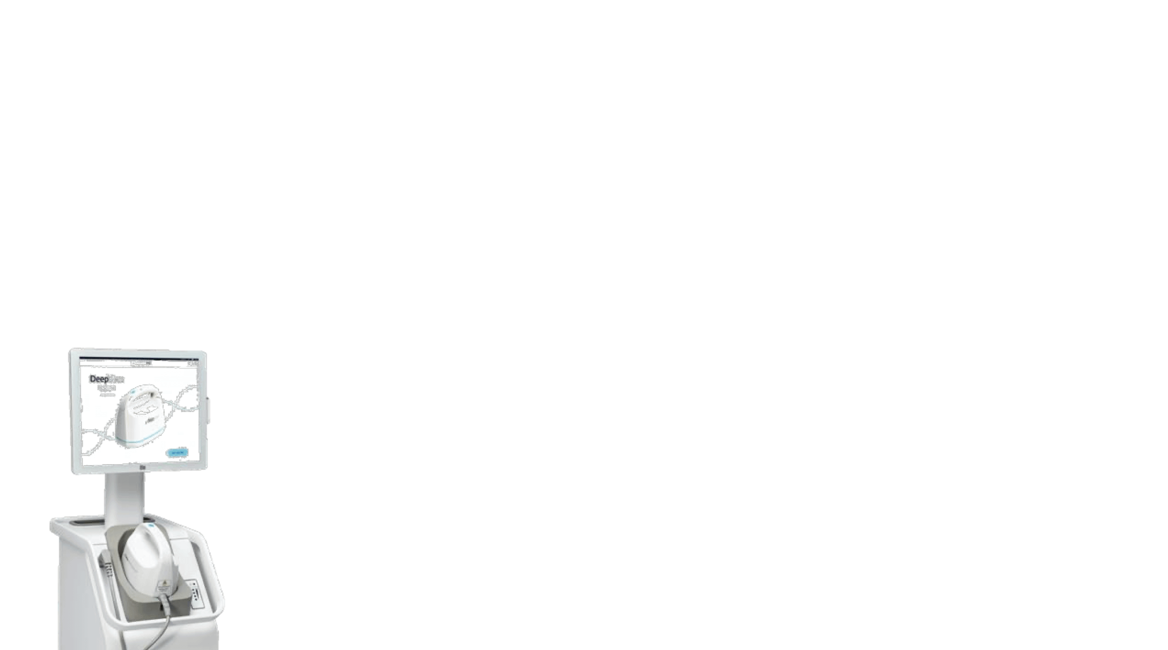
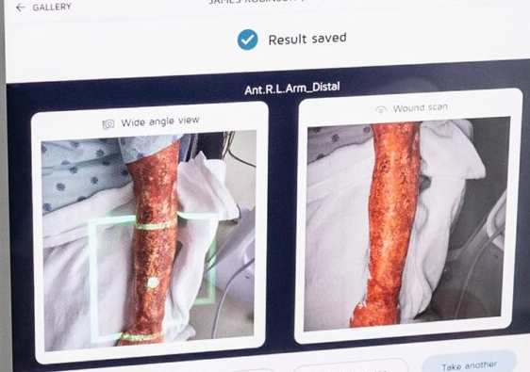
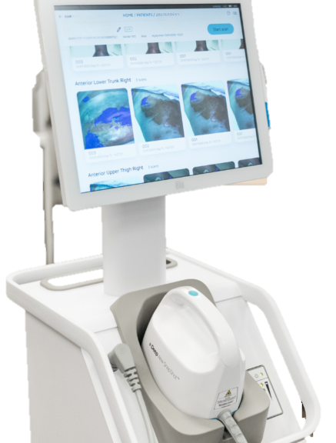
Future directions
Will AI take over from clinician prediction?

Slide 25


No but…
.
Future possibilities
Combined approach → earlier, more accurate decisions
Potential: improve outcomes? reduce delays?
Can augment
Clinicians integrate tactile cues and patient comorbidities.
AI: rapid, objective, reproducible imaging-based predictions.
Synergy, not substitution
Help reduce variability in initial/remote settings.
Clinician experience essential in complex/ borderline cases
Notes:
Can augment
Clinicians integrate tactile cues: capillary refill, sensation, texture, patient comorbidities.
AI provides rapid, objective, reproducible imaging-based predictions.
Synergy, not substitution
AI may help reduce variability in early/remote settings.
Clinician experience remains essential in complex or borderline cases.
Future possibilties
Combined approach → earlier, more accurate decision-making.
Potential to improve outcomes and reduce unnecessary delays.

Slide 26
Conclusion
SpectralAI provides rapid, non-invasive healing predictions.
Performance not yet comparable to experienced burns specialists, but can also be user dependent
Potential role as a decision-support tool in the future:
Primary care / ED referrals
Burn unit decision making

