Slide 1

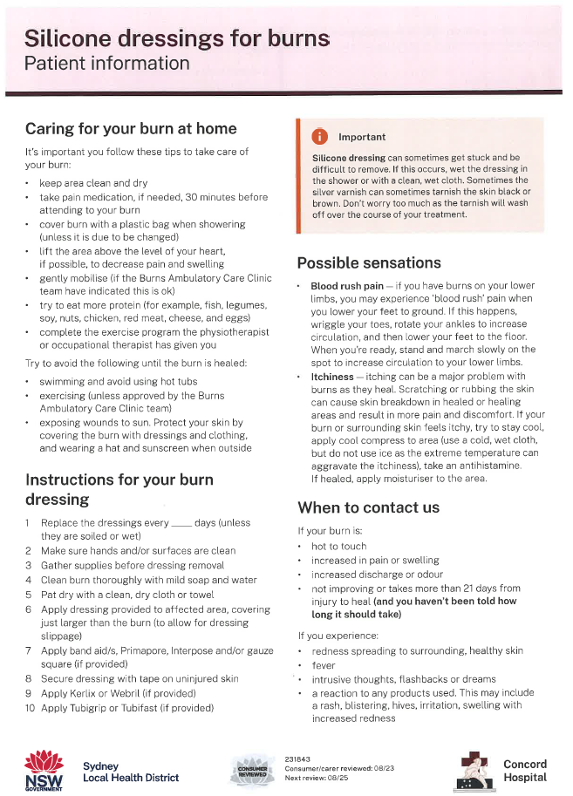
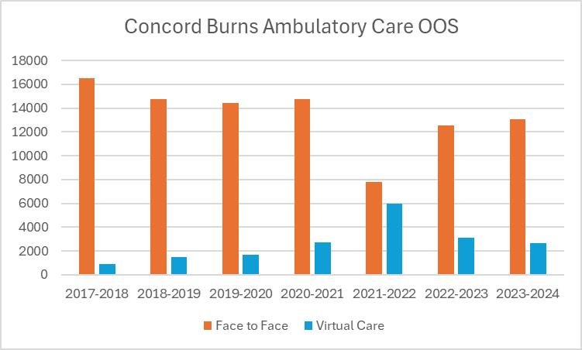
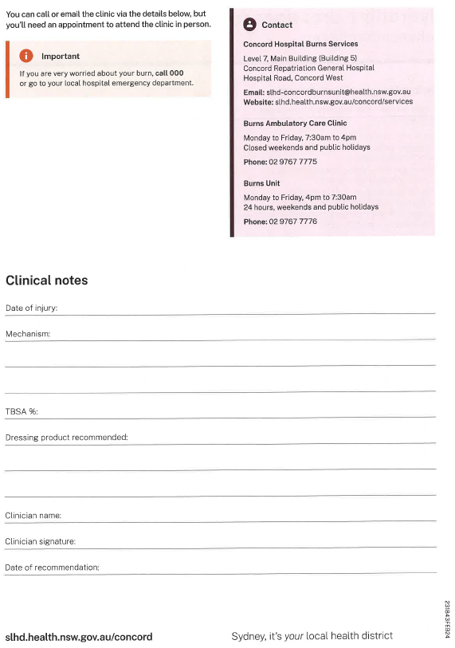
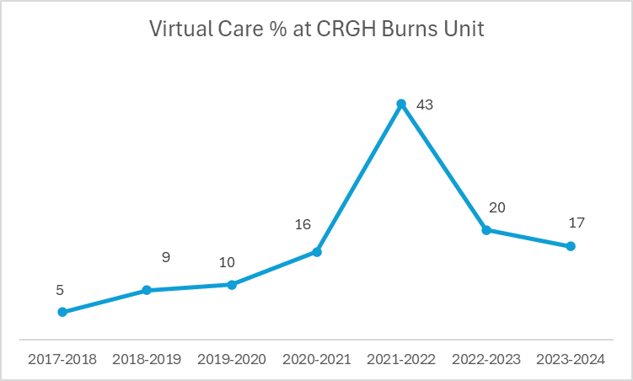
Fostering Patient Independence and Self-management
Through a Burn Journey
Emma Allan
Concord Repatriation General Hospital
Introduction
Results
ANZBA ASM 2025
The Concord Ambulatory Care Clinic supports burns patients post discharge and patients requiring specialised care with and/or without admission. Serving 11 different health districts, the clinic delivers around 14,000 occasions of service (OOS) annually both in-person and via telehealth.
This project was commenced due to recent patient feedback requesting more written information and flexibility in attending their own wound care in their home. The primary aim was to develop clear and concise wound care education pamphlets that facilitated independent wound care for patients and/or their families. The secondary aim was to meet NSW Health KPI for Telehealth services of 30% for all non- admitted patients. From 2020-2023, 19% of services were delivered via telehealth at Concord.
Front:
Back:
Methods
The project lead decided to draft wound dressing educational pamphlets. The decision was made to design 8 commonly used dressings, creams and solutions. The pamphlets were categorised into dressing classifications such as Hydrocolloids, Hydrofibre, Alginate, Silicone, Impregnated glaze, Acticoat®, Steroid cream & Betadine®. This was to avoid where possible using brand names and allow for both the medicated and unmedicated variations in products.
Steps:
A draft was formed
A working party consisting of senior medical and nursing staff within the burns team reviewed and provided feedback
Minor changes were made post clinician feedback
The drafts were sent to SLHD consumer group for review and approval
Once approved, the pamphlets were sent to the SLHD design team and printed
The pamphlets were implemented for use
Challenges and Next Steps
This twelve (12) month development process resulted in pamphlets that have now been in use for eighteen (18) months, receiving positive feedback from both clinicians and consumers. One key challenge was the highly specialised nature of burn care, making it difficult to clearly communicate instructions and early warning signs. Additionally, the design needed to remain brand-neutral while covering a large scope of dressing materials.
The next steps involve developing a Patient Reported Outcome Measure (PROM) to evaluate the strengths and limitations of the pamphlets. On analysis of data and PROM results, the pamphlets will then be transcribed into other key languages. Collaboration has also begun with PT, OT and theatre coordinator to further develop future educational resources.
Acknowledgement
Tamar Millar Miranda Pye Megan Brady Monica Ditu Sue Taggert Prof. Peter Maitz SLHD Consumer group

